Slide 1
Prefix-Suffix
Using root words, prefixes and suffixes.
Notes:
Jan 2012. Kindly contributed to www.skillsworkshop.org by Helen Holt, Lincoln College.

Slide 2
Session outcomes
To understand the terms ‘root’, ‘prefix’ and ‘suffix’;
To use these to help with spelling and working out the meaning of unfamiliar words.
Notes:
Jan 2012. Kindly contributed to www.skillsworkshop.org by Helen Holt, Lincoln College.

Slide 3
Root Words:
A root word stands on its own as a word.
You can make new words from it by adding beginnings (prefixes) and endings (suffixes).
Example: 'comfort' is a root word.
By adding the prefix 'dis' or the suffix 'able' you can make new words such as 'discomfort' and 'comfortable'.

Slide 4
What Are Prefixes?
A prefix is a group of letters we add to the front of a root word.
Knowing about them may help you spell and predict meanings.
Prefixes change the meaning or purpose of the word, e.g.:
un + kind = unkind
Notes:
Jan 2012. Kindly contributed to www.skillsworkshop.org by Helen Holt, Lincoln College.

Slide 5
Here are some common prefixes:
Un (not) | Dis | Mis | Co | Ex | Re (again)
Unidentified | Dislike | Misbehave | Co-operate | Exclaim | Refill
Unwell | Disorder | Misread | Co-star | Exterior | Replay
Unhappy | Disrespect | Mistake | Co-ordinate | Explode | Reappear
Unhealthy | Disagree | Miscount | Co-writer | Ex-boyfriend | Re-examine
Undress | Distress | Misfortune |  |  | Rewrite
Untidy | Disable | Misconceive |  |  | Rearrange

Slide 6
Prefixes using ‘Un’:
un
finished
un
do
un
fit
un
un
pack
un
well
un
load

Slide 7
What Are Suffixes?
A suffix is a word ending. It is a group of letters you can add to the end of a root word.
e.g. walking, helpful, happily
Adding suffixes to words can change or add to their meaning, but most importantly they show how a word will be used in a sentence and what part of speech (e.g. noun, verb, adjective) the word belongs to.
Notes:
Jan 2012. Kindly contributed to www.skillsworkshop.org by Helen Holt, Lincoln College.

Slide 8
Example:
If you want to use the root word 'talk' in the following sentence:
I was (talk) to Samina.
You need to add the suffix 'ing' so that the word 'talk' makes better sense grammatically:
"I was talking to Samina".
Notes:
Jan 2012. Kindly contributed to www.skillsworkshop.org by Helen Holt, Lincoln College.

Slide 9
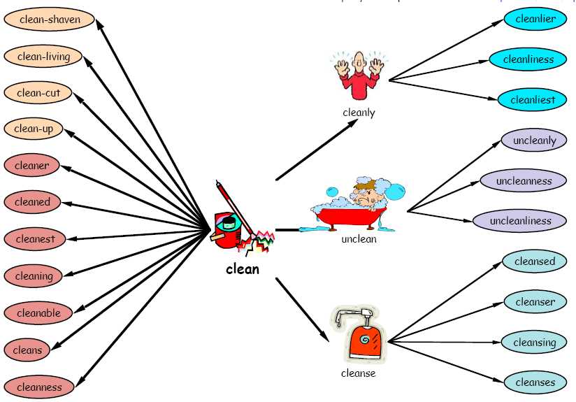
Notes:
Jan 2012. Kindly contributed to www.skillsworkshop.org by Helen Holt, Lincoln College.

Slide 10
Here are some suffixes:
Suffix | Example |  | Suffix | Example
ed | walk + ed = walked |  | ness | happy + ness = happiness
ing | say + ing = saying |  | al | accident + al = accidental
er | tall + er = taller |  | ary | imagine + ary = imaginary
tion | educate + tion = education |  | able | accept + able = acceptable
sion | divide + sion = division |  | ly | love + ly = lovely
cian | music + cian = musician |  | ment | excite + ment = excitement
fully | hope + fully = hopefully |  | ful | help + ful + helpful
est | large + est = largest |  | y | ease + y = easy
Notes:
Jan 2012. Kindly contributed to www.skillsworkshop.org by Helen Holt, Lincoln College.

Slide 11
Any Questions?
Notes:
Jan 2012. Kindly contributed to www.skillsworkshop.org by Helen Holt, Lincoln College.

